Slide 1
SWIFFT: A Modest Proposal For FFT Hashing
Vadim Lyubashevsky UCSD
Daniele Micciancio UCSD
Chris Peikert SRI International
Alon Rosen Herzliya IDC

Slide 2

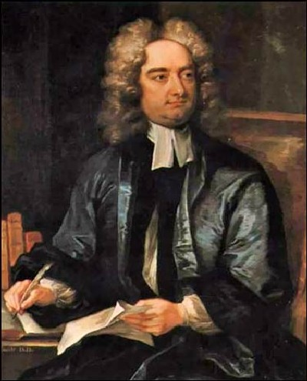
Notes:
A MODEST PROPOSAL – Satirical pamphlet, written in 1729 by Jonathan Swift, author of ``Gulliver’s Travels.” Swift was a prolific writer and ``pamphleteer,” which is somebody who creates and distributes pamphlets (used to broadcast somebody’s opinion on a subject). If he lived today he would have been called a ``blogger.” He typically used a pseudonym, or published anonymously.
The essay is a well known example of sustained irony. However, we are not being ironic. We are serious…

Slide 3
SWIFFT
A collection of compression functions
  Efficient
  Highly parallelizable
  Supporting proof of security
Not an “all-purpose” function
  In particular, it is linear: f(x+y) = f(x) + f(y)
  However, has many desirable properties
      Cryptographic
      Statistical
FFT
Notes:
SWIFFT is not an acronym. It stands for ``swift” (= fast) + FFT
The FFT suffix alludes to the fact that it is based on the FFT algorithm.
This makes the compression function fast and highly parallelizable.
An important feature of our compression function is that its security is supported by a proof (reduction).
Any ``systematic” method for finding collisions can be transformed into a method for finding short vectors in cyclic/ideal lattices in the worst case.
Finding a solution to the SVP is a long standing open question.
Traditionally, it has been assumed to be hard for general lattices.
Here we make a stronger assumption. Namely, that for every polynomial time algorithm, there exist some cyclic lattice for which the algorithm fails to find a short vector.

Slide 4


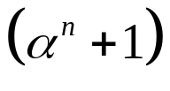
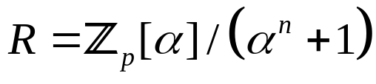

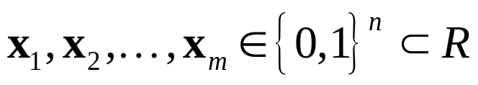
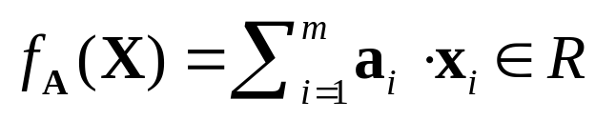
Our Starting Point
At a (very) high-level:
  Key: m random deg < n polynomials in
  Input: m polynomials w/ binary 0-1 coefficients
  Function: compute sum of products
All arithmetic modulo and
  Key :
  Input:
  Function:
Notes:
Polynomial are of degree <n and their coefficients are elements between 0 and p-1.Polynomial addition and multiplication is performed modulo (\alpha^n +1), where \alpha is the indeterminate.
Key is not meant to be secret. It is a public value that described the function.
Knapsacks, as well as subset-sum have a long and infamous history. We focus on their use in the context of hash functions. Here, attacks do not exploit a special structure relating to the existence of an embedded trapdoor.

Slide 5

Supporting Proof of Security
For random key , the function is collision resistant, assuming worst-case hardness in cyclic/ideal lattices [PR06, LM06].
  Continues a long line of works [Ajtai96,…,Mic02]
  proof is asymptotic
  meaningful only for large parameters
In this work:
  Concrete parameters (m=16, n=64, p=257)
  Function maps 1024 bits to 528 bits
  Very efficient implementation.
  Security proof suggests that design is sound
  Heuristic analysis suggests that parameters are sound
Notes:
For the proof to be meaningful, the parameters need to be large. Otherwise, we get a reduction that solves lattice problems on dimensions for which practical attacks actually work (both due to low dimension and large approximation factors).
Parameters are different than the version we presented in the NIST hash workshop. They are geared towards an efficient implementation.

Slide 6
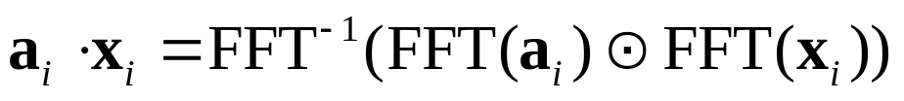


Towards Efficient Implementation
Central Observations:
  Polynomial multiplication ⇔ FFT
  Can pre-compute
  No need to compute FFT⁻¹
  Specifics of allow FFT optimization
      Can perform modular FFT (NTT)
      FFT of dimension n is sufficient
Resulting function is completely equivalent (security-wise).
Notes:
FFT is a very efficient algorithm. Requires O(n logn) operations with a small constant. Very well studied. Can implement efficiently both in hardware and in software.
FFT is efficiently invertible. So collisions for the function without the FFT inverse yield collision for the function with it (in polynomial time).
The FFT modulo (\alpha^n+1) will work similarly to the one modulo (\alpha^n-1).

Slide 7

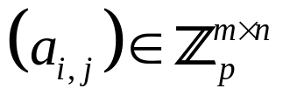

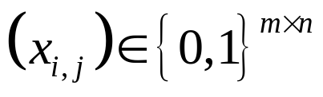
SWIFFT
  Parameters:
  Key: matrix
  Input: binary matrix
Key
Input
a_{1,1}
a_{1,2}
a_{1,n}
x_{1,1}
x_{1,2}
x_{1,n}
a_{2,2}
a_{2,2}
a_{2,n}
x_{2,2}
x_{2,2}
x_{2,n}
a_{m,1}
a_{m,2}
a_{m,n}
x_{m,1}
x_{m,2}
x_{m,n}
∈
m x n
∈
m x n
ℤ_{p}
{0,1}

Slide 8
SWIFFT
  Parameters:
  Key: matrix
  Input: binary matrix
Key
All arithmetic in ℤ_{p}
m x n
+
Output
x
Input
( )
FFT
∈
1 x n
m x n
ℤ_{p}
Notes:
The key should be chosen using some trusted source of randomness (e.g. the digits of \pi). Otherwise, it may be possible for somebody to “plant” collisions into the function.
The FFT we use is in fact mFFT (called NTT in the literature). Operations are done with modular arithmetic. This is made possible by our specific choices of parameters.

Slide 9

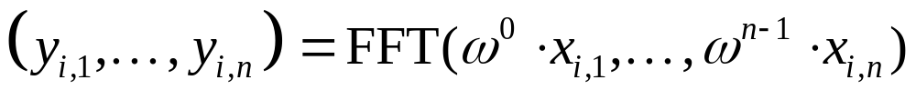


SWIFFT (m=3)
x_{1,1}
x_{1,2}
x_{1,n}
x_{2,1}
x_{2,2}
x_{2,n}
x_{3,1}
x_{3,2}
x_{3,n}
w ⁰
w ¹
x
w ^{n-1}
w ¹
w ⁰
w ¹
x
x
w ^{n-1}
x
w ^{n-1}
x
w ⁰
x
x
x
x
x_{1,1}
x_{1,2}
x_{1,n}
x_{2,1}
x_{2,2}
x_{2,n}
x_{3,1}
x_{3,2}
x_{3,n}
3 x n
Step 1: For each row compute:
where is a 2n^{th} root of unity in
Notes:
The multiplications by powers of w are a trick that enables to save on the dimension of the FFT. Works because w is a 2nth root of unity in Zp.

Slide 10
SWIFFT (m=3)
x_{1,1}
x_{1,2}
x_{1,n}
x_{2,1}
x_{2,2}
x_{2,n}
x_{3,1}
x_{3,2}
x_{3,n}
w ⁰
w ¹
x
w ^{n-1}
w ¹
w ⁰
w ¹
x
x
w ^{n-1}
x
w ^{n-1}
x
w ⁰
x
x
DIFFUSION
x
x
FFT
FFT
FFT
y_{1,1}
y_{1,2}
y_{1,n}
y_{2,1}
y_{2,2}
y_{2,n}
y_{3,1}
y_{3,2}
y_{3,n}
a_{1,1}
a_{1,2}
a_{1,n}
a_{2,1}
a_{2,2}
a_{2,n}
a_{3,1}
a_{3,2}
a_{3,n}
x
x
x
x
CONFUSION / COMPRESSION
x
x
x
x
x
+
+
+
z₁
z₂
z_{n}

Slide 11
SWIFFT (m=3)
x_{1,1}
x_{1,2}
x_{1,n}
x_{2,1}
x_{2,2}
x_{2,n}
x_{3,1}
x_{3,2}
x_{3,n}
w ⁰
w ¹
x
w ^{n-1}
w ¹
w ⁰
w ¹
x
x
w ^{n-1}
x
w ^{n-1}
x
w ⁰
x
x
x
x
FFT
FFT
FFT
y_{1,1}
y_{1,2}
y_{1,n}
y_{2,1}
y_{2,2}
y_{2,n}
y_{3,1}
y_{3,2}
y_{3,n}
a_{1,1}
a_{1,2}
a_{1,n}
a_{2,1}
a_{2,2}
a_{2,n}
a_{3,1}
a_{3,2}
a_{3,n}
x
x
x
x
x
x
x
x
x
+
+
+
z₁
z₂
z_{n}

Slide 12

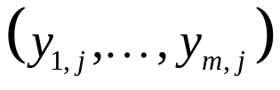
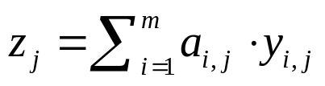
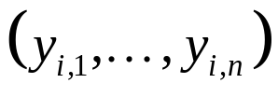
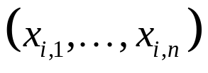
SWIFFT (m = 16, n = 64, p=257)
nm = 1024 bits
Hard to solve simultaneously
n log₂ p ~ 528 bits
Easy to find solution to each individually
  The reason: are highly constrained
    Dependency through FFT
    Need to find binary
  This way of “breaking linearity” is different from previous proposals for FFT hashing [S91,S92,SV93,V92].
Notes:
Note: Easy to solve (y1j,…,1mj). Moreover. admits many solutions.
However: seems hard to solve for (z1,..,zn) simultaneously.
The reason: (yi1,…,yin) are highly constrained.
Dependency through FFT
Need to find binary (xi1,…,xin)

Slide 13


Choice of Parameters (m=16, n=64, p=257)
Security considerations:
  Subset-sum instance from 1024 to 528 bits.
  n = 2^{k} ⇔ modulus polynomial is irreducible (over ℚ)
      crucial for security proof
      otherwise can find collisions (LASH, [Mic02] OWF).
      Enables to avoid straightforward weaknesses
Performance considerations:
  p=257 is a prime of the form p = 4n+1
  enables efficient 64-dimensional modular FFT.
      is a field
      is a 128th root of unity
      Odd powers of w are the roots of
Notes:
The function looks like a random subset-sum instance with 1024 bits of input and 528 bits of output (with induced structure). These are considered to be hard problems.
Irreducibility of modulus polynomial is important for security proof. This is relevant. In fact, if the polynomial is reducible then it is possible to find collisions (cf. LASH, Micciancio’s one-way function). Enables to avoid straightforward structural weaknesses.

Slide 14
Fast Implementation
90% OF THE WORK
To improve performance:
  Use lookup tables inside FFT.
  Parallelize atomic operations (+,x).
  Avoid modular reductions (whenever possible).
  Multiply by w powers using left shifts.

Slide 15
Speeding up the FFT
  Input to FFT is a binary vector:
    Few possible intermediate values.
    Can pre-compute and store in lookup table.
  FFT is highly parallelizable:
    Reduce FFT₆₄ to 8 parallel FFT₈
    Use SIMD (single-instruction multiple-data) instructions to perform operations in parallel.
    Point-wise vector addition/multiplication on 8 dim. registers (w/ 16 bit signed integer entries).
x
x
x
x
x
x
x
x
Notes:
We rely on two observations.

Slide 16

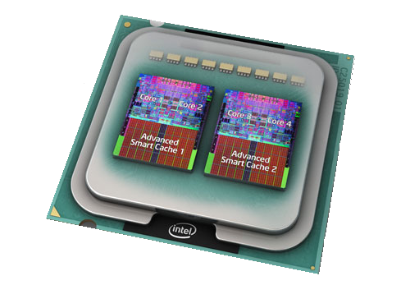
Further Optimizations
Use of ℤ₂₅₇:
  ω = 42 is a 128th root of unity mod 257.
  FFT₈ uses ω¹⁶ = 2² (mod 257).
  Multiplications by powers of ω¹⁶ using left shifts.
  Can avoid most modular reductions w/out overflow.
  Use SIMD for parallel modular reduction.
Multi-core processors:
  FFTs are completely independent.
  We did not exploit multi-core capabilities yet

Slide 17
Performance
Implemented and tested:
    On 3.2 GHz Intel Pentium 4.
    Written in C (using INTEL intrinsics for SSE2).
    Compiled using gcc 4.1.2 on Linux kernel 2.6.19.
Compared to SHA256:
    Same system
    openssl version 0.9.8 speed benchmark
Results:
    SWIFFT - Throughput ~40 MB/s
    SHA256 - Throughput ~47MB/s

Slide 18
Statistical/Cryptographic Properties
Statistical properties (no computational assumptions):
    Universal hashing
    Regularity
    Randomness extraction
Cryptographic properties:
    One-wayness
    Second-preimage resistance
    Target collision resistance
    Collision resistance
We aim for 2¹⁰⁰ security. We do NOT claim:
    2⁵²⁸ security against inversion attacks
    2^{528/2} security against collision attacks
Notes:
Just like with RSA you do not require 2^1024 security when the modulus is 2048 (since existence of sub-exponential algorithms is taken into consideration).

Slide 19
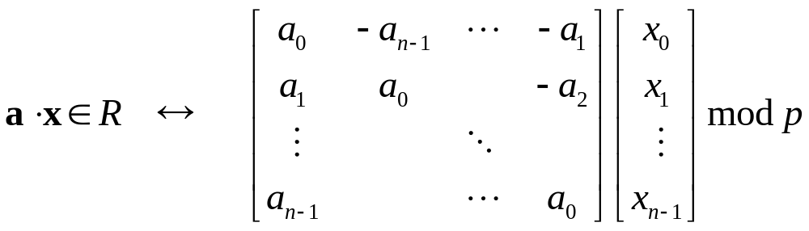




Concrete Security Analysis
A convenient way to view SWIFFT is as a subset-sum instance:
Our function can be viewed as multiplying a vector
with a matrix where is the skew-circulant
matrix that corresponds to
Best known attack:
  Wagner’s generalized birthday attack.
  Has complexity 2¹⁰⁶
Lattice reduction algorithms do not do as well.

Slide 20
Conclusions
SWIFFT: FFT-based hashing
  Provably secure design (under worst-case assumption)
  Concrete instantiation w/ heuristic security analysis
  Highly efficient implementation
Future directions
  Further cryptanalysis (possibly algebraic)
  Faster implementation
  Shorter output/smaller description
  Exploiting linearity for applications

